Slide 1
Data analysis with tableau
Submitted By: Riyaben Patel(104885725)
Nirali Pandya(104864205)
Shrey Gupta(104915774)

Slide 2
Tableau
Tableau is an industry leading business intelligence-BI tool which is better compare to all because of its data visualization, dashboarding and data discovery features. Tableau is primarily used for:
Creating dashboard, reports
Data discovery and Visualization
Self-Service BI
Simple statistical analytics like trends and forecasting

Slide 3
Why tableau?
Beautiful visualization
Powerful computation
Enhanced user-experience
Use of other scripting languages
Quick insights
Proved to have satisfied customers

Slide 4
Hyper
Tableau’s new in-memory data engine technology
Designed for fast data ingest and analytical query processing on large or complex data sets
.hyper replaces .tde(tableau data extract) format
Upto 3x faster extract creation and 5x increase in query performance
Hyper is a compiling query engine and is CPU optimized
Upgrading to Hyper is seamless, no data migration is needed

Slide 5
Environment of Tableau
Tableau Desktop
Tableau Online
Tableau Reader
Tableau Public
Tableau Server

Slide 6
Data analysis on tornadoes in USA
Attained tornadoes data source from NOAA Storm Prediction Center
Data source contains data since 1950 to 2017
Data source contains data about tornadoes that were recorded in various states of USA with date, time, magnitude, loss incurred, geolocations, length and width.

Slide 7
Tornadoes classification
Tornadoes are classified by their damage according to the Enhanced Fujita (EF) scale.
Weak Tornadoes
EF0: 65-85 mph – light damage
EF1: 86-110 mph – moderate damage
Strong Tornadoes
EF2: 111-135 mph - considerable damage
EF3: 136-165 mph – severe damage
Violent Tornadoes
EF4: 166-200 mph – devastating damage
EF5: 201+ mph – incredible damage

Slide 8
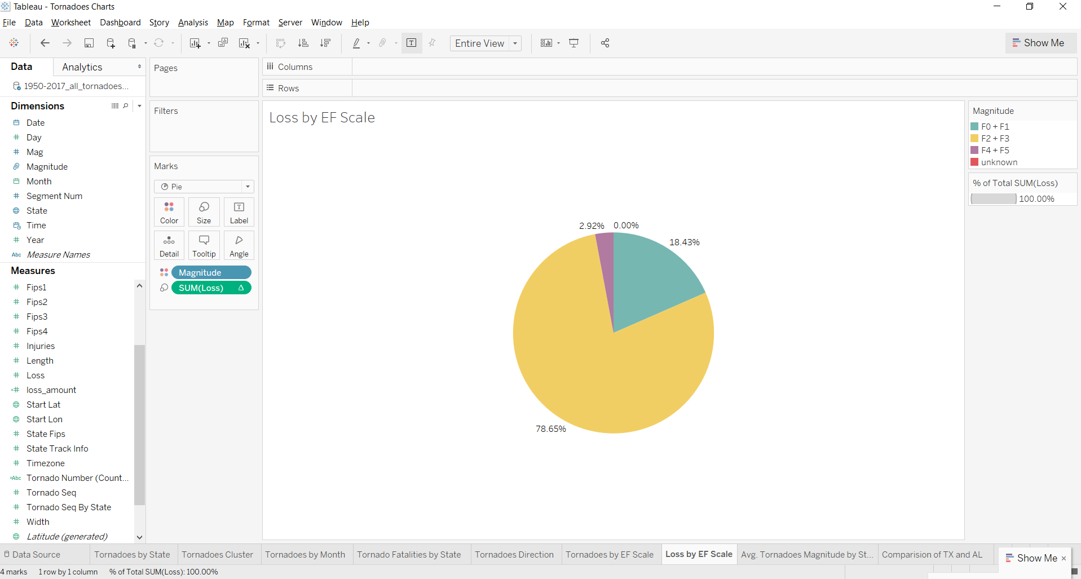
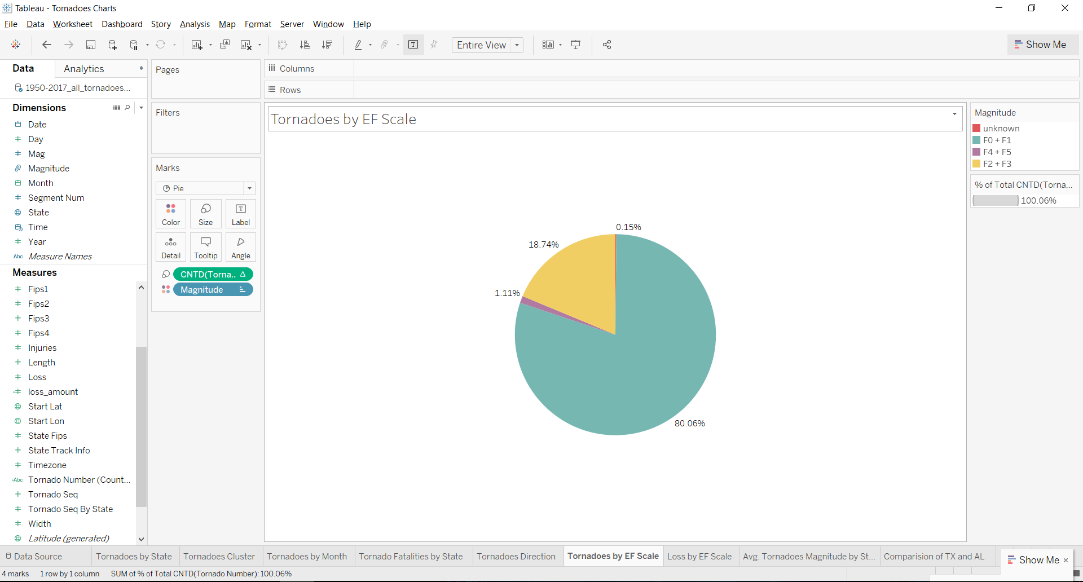
Tornadoes and loss by ef scale

Slide 9
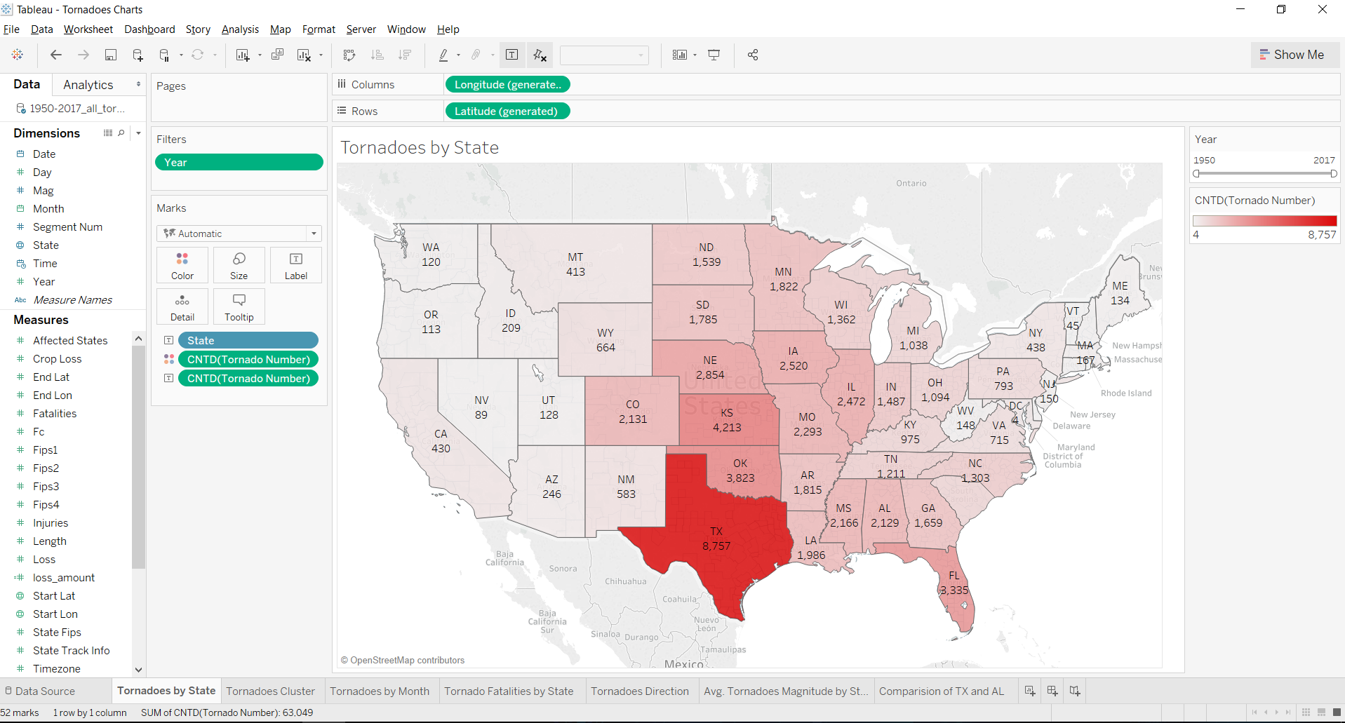
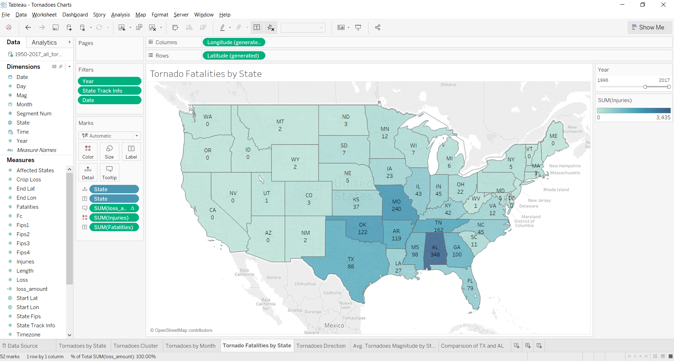
Tornadoes and Fatalities by state

Slide 10
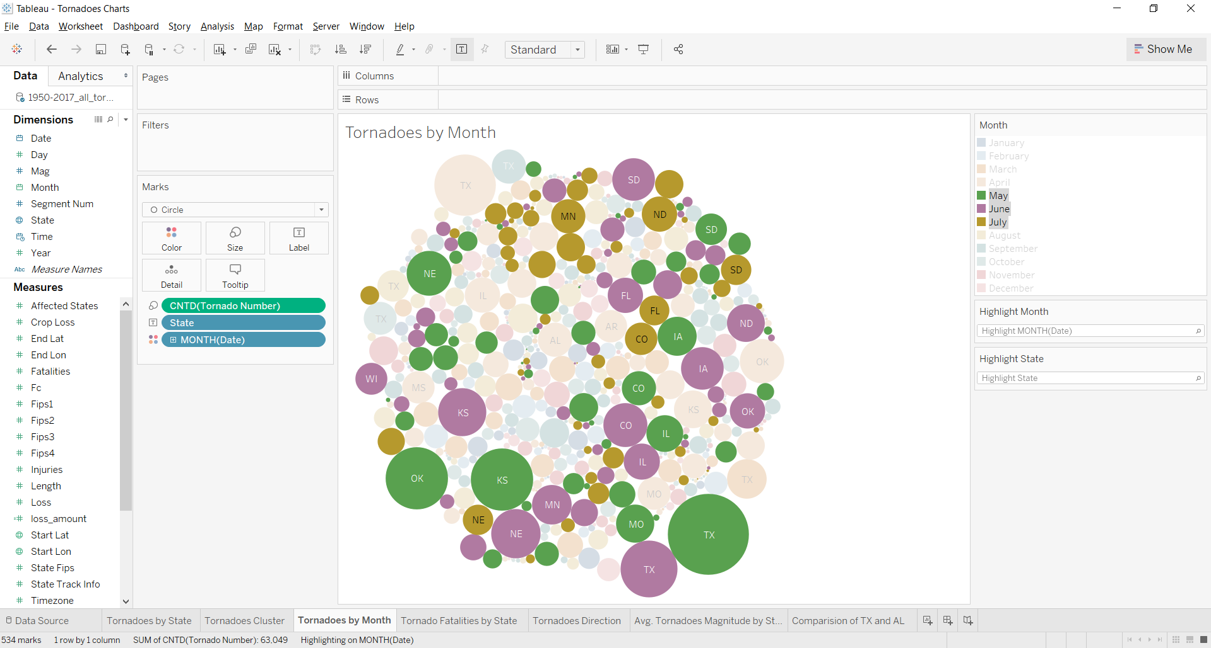
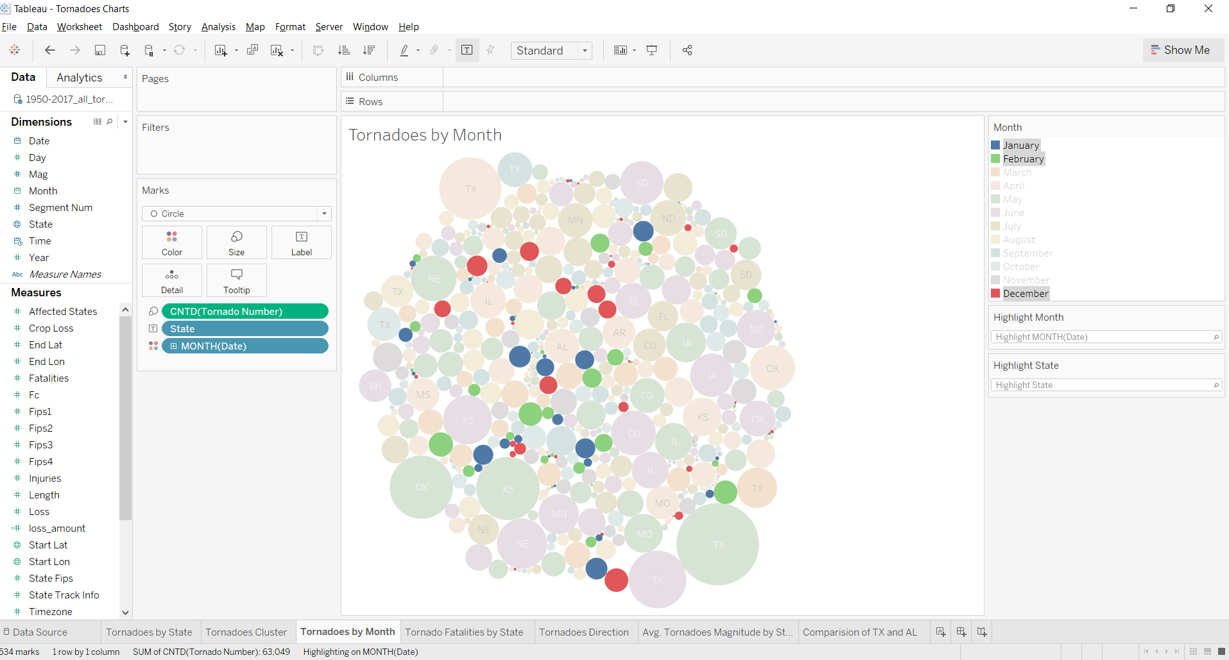
Tornadoes by month

Slide 11
Tornado statistics
The average tornado moves from southwest to northeast, but tornadoes have been known to move in every direction
Tornadoes can occur at any time of the year, with a peak in the U.S. from March to July
Tornadoes cluster in central US
Texas ranks No. 1 in most frequent tornadoes
Alabama ranks No. 1 in most violent tornadoes

Slide 12
DEMO

Slide 13
References
https://cdn.intellipaat.com/blog/wp-content/uploads/2014/06/Tableau-Server.png
https://cdn.intellipaat.com/blog/wp-content/uploads/2014/06/Tableau-Online.png
https://www.tableau.com/support
http://www.crh.noaa.gov/Image/dvn/downloads/quickfacts_Tornadoes.pdf
http://www.spc.noaa.gov/wcm/#data

Slide 14
THANK YOU!

